Slide 1
SOCIAL MEDIA ANALYTICS: AN OVERVIEW

Slide 2
Contents
Purpose of Social Media Analytics Social Media vs. Traditional Business Analytics
Seven Layers of Social Media Analytics
Layer One: Text
Layer Two: Networks
Layer Three: Actions
Layer Four: Mobile
Layer Five: Hyperlinks
Layer Six: Location
Layer Seven: Search Engines
Types of Social Media Analytics
Descriptive Analytics
Predictive Analytics
Prescriptive Analytics
Social Media Analytics Cycle
Challenges to Social Media Analytics

Slide 3
Social Media Analytics: Overview
Social media analytics is the process of extracting valuable insights from social media data to perform decision making.
By analyzing social media data, businesses can increase brand loyalty, generate leads, drive traffic, and make forecasts.
Social media analytics can also be used to increase awareness of a brand and drive users to a website for the latest news and information.

Slide 4
Purpose of Social Media Analytics
The purpose of social media analytics is to enable informed decision making by leveraging social media data. This involves answering questions such as:
What are customers saying about a brand or product on social media?
Which content posted on social media is resonating more with customers?
How can social media data be used to improve products or services?
Is the social media conversation about a company, product, or service positive, negative, or neutral?
How can social media be used to promote brand awareness?
Who are the influential followers, fans, and friends on social media?
Who are the influential nodes (people and organizations) on social media and their position in the network?
Which social media platforms are driving the most traffic to a corporate website?
Where are the social media customers located geographically?
Which keywords and terms are trending on social media?
How active is social media in a business and how many people are connected with the company?
Which websites are connected to a corporate website?
How are competitors performing on social media?

Slide 5
Social Media Vs Traditional Business Analytics
The main difference between social media analytics and traditional business analytics is the source, type, and nature of the data being mined.
Social media analytics involves the collection, analysis, and interpretation of semistructured and unstructured social media data, while traditional business analytics uses structured and historical data.
Social media data is diverse, high volume, real-time, and stored in third-party databases in semistructured and unstructured formats, while traditional business data is mostly stored in databases and spreadsheets in machine-readable format.
Social media data is socialized in nature and originates from the public internet, while traditional business data is bureaucratic and formal in nature and is controlled by organizations.
The value of social media data is determined by the extent to which it is shared with other social entities, while the value of traditional business data is often confined within organizational databases and serves as a source of competitive advantage.

Slide 6
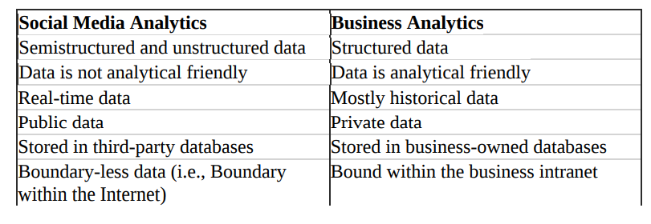
Social Media Vs Traditional Business Analytics

Slide 7
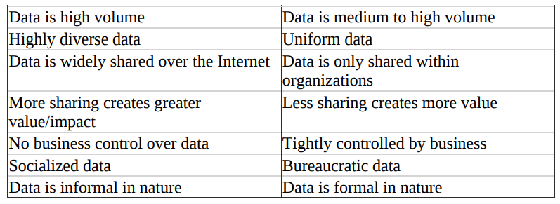
Social Media Vs Traditional Business Analytics

Slide 8
Seven Layers of Social Media Analytics
Social media has a minimum has seven layers of data (Figure 2).
Each layer carries potentially valuable information and insights that can be harvested for business intelligence purposes.
Out of the seven layers, some are visible or easily identifiable (e.g., text and actions) and other are invisible (e.g., social media and hyperlink networks).
The following are seven social media layers
1. Text
2. Networks
3. Actions
4. Hyperlinks
5. Mobile
6. Location
7. Search engines

Slide 9
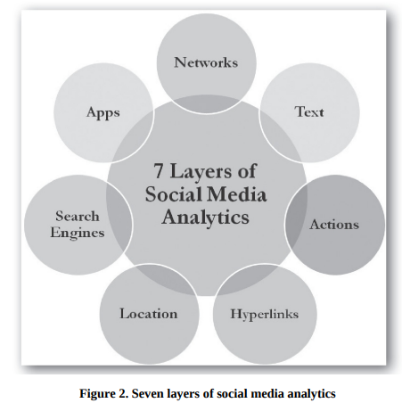
Seven Layers of Social Media Analytics

Slide 10
Seven Layers of Social Media Analytics
Social media analytics involves analyzing data from seven layers:
Text: This includes the content of social media posts, such as comments, tweets, blog posts, and Facebook status updates. It is used to understand user sentiments and identify emerging themes and topics.
Networks: This includes the connections between users and the relationships between them, such as followers and friends on social media. It is used to identify influential nodes (people and organizations) and their position in the network.
Actions: This includes the actions taken by users on social media, such as likes, comments, shares, and other interactions. It is used to measure popularity, influence, and prediction in social media.

Slide 11
Seven Layers of Social Media Analytics
Social media analytics involves analyzing data from seven layers:
4. Mobile: This includes data related to the use of social media on mobile devices, such as the type of device used, the operating system, and the location of the user. It is used to measure and optimize user engagement with mobile applications.
5. Hyperlinks: This includes the links between social media posts and other websites, as well as the content of those linked websites. It is used to reveal Internet traffic patterns and sources of incoming or outgoing traffic.
6. Location: This includes data on the geographical location of users and the location-specific content they engage with on social media. It is used to mine and map the locations of social media users, content, and data.
7. Search engines: This includes data on how users find and access social media content through search engines, as well as the keywords they use in their searches. It is used to analyze historical search data for trends analysis, keyword monitoring, and advertisement history.

Slide 12
Social Media Analytics Types
There are three main types of social media analytics:
Descriptive analytics: This involves gathering and describing social media data in the form of reports, visualizations, and clustering to understand a business problem. Examples include actions analytics (e.g., number of likes, tweets, and views) and text analytics.
Predictive analytics: This involves analyzing large amounts of accumulated social media data to predict a future event. For example, analyzing social media posts to predict future purchasing behavior or using historical website visits to predict future sales figures.
Prescriptive analytics: This involves suggesting the best action to take when handling a scenario based on analyzing patterns of behavior. It has not yet been widely applied to social media data.

Slide 13
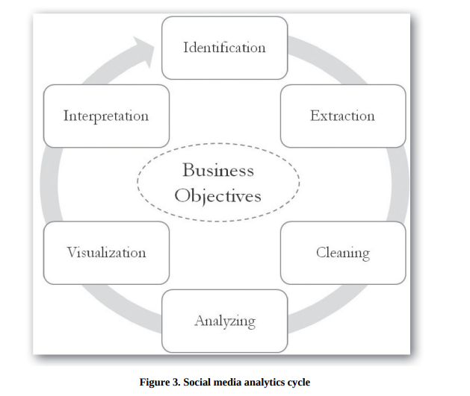
Social Media Analytics Lifecycle

Slide 14
Social Media Analytics Lifecycle
The social media analytics process involves six steps to mine desired business insights from social media data. The process begins with defining business goals and objectives, and continues until these objectives are fully satisfied.
The six general steps are:
Data collection: Gathering relevant data from social media platforms.
Data processing: Cleaning and preparing the data for analysis.
Data analysis: Analyzing the data using various methods and tools to uncover insights.
Insights generation: Interpreting the results of the analysis to generate insights.
Insights communication: Communicating the insights to relevant stakeholders.
Insights implementation: Using the insights to inform business decisions and actions.

Slide 15
Step1 - Identification
The identification stage of social media analytics involves finding the right sources of data to analyze in order to gain valuable business insights.
The data should be aligned with the business's objectives and can come from both official business-owned platforms, such as social media accounts and blogs, and nonofficial platforms such as Google search trends or Twitter search stream data.
It is important to consider the business objectives when identifying the sources and types of data to be analyzed.

Slide 16
Step2 - Extraction
The extraction stage of social media analytics involves using appropriate methods and tools to gather data from identified sources. This can include manual data collection for small-scale data and automated extraction using APIs (application programming interfaces) for larger data sets.
It is important to consider privacy and ethical issues when mining data from social media platforms and to have a clear social media privacy policy in place to ensure that data handling and extraction practices do not violate user privacy.
Specialized tools may be needed to extract certain types of data, such as social network and hyperlink network data.

Slide 17
Step3 - Cleaning
The cleaning step in social media analytics involves removing unwanted data from the collected data set.
This can involve processes such as coding, filtering, clustering, and natural language processing to remove irrelevant data.
Both automated and manual techniques may be used for cleaning, depending on the type of data and the desired level of accuracy.

Slide 18
Step 4- Analyzing
The analyzing stage of social media analytics involves using clean data to identify valuable insights for the business.
The approach and techniques used will depend on the type of data being analyzed and the tools and algorithms employed.
It is important to maintain the integrity of the data while extracting meaningful insights and to have a good understanding of the capabilities of the tools being used.

Slide 19
Step 5 - Visualization
The visualization step in social media analytics involves creating visual representations of the results of the analysis
Visualization can help reveal hidden patterns, relationships, and trends in complex and large data sets
Different types of data will result in different types of visualizations, including network data, topical data, temporal data, and geospatial data
Other types of visualizations include trees, hierarchical graphs, and heat maps
Effective visualization is important for effectively communicating the results of the analysis to top management

Slide 20
Step 6 : Interpretation
Interpret and translate analytics results into a meaningful business problem.
Two strategies or approaches used are:
1) Producing easily consumable analytical results and
2) Improving analytics consumption capabilities

Slide 21
Challenges to Social Network Analysis
Volume and Velocity is a challenge
Diversity Challenge- Social media users and content they generate are extremely diverse, multilingual, and vary across time and space.
Unstructuredness as a challenge

Slide 22
Social Media Analytics Tools
Layer of social media | Example of tools
Text | Discovertext Lexalytics Demo :Video Link Archivist Twitonomy Netlytic LIWC Voyant
Actions | Lithium Twitonomy Google Analytics Video Demo : Video Link SocialMediaMineR
Network | NodeXL UCINET Pajek Netminer Flocker Netlytic Reach Mentionmapp

Slide 23
Mobile | Countly Mixpanel Google Mobile Analytics
 | Google Fusion Table
Location | Tweepsmap Trendsmap Followerwonk Esri Maps Agos
Hyperlinks | Webometrics Analyst VOSON
Research Engines | Google Trends

Slide 24
Questions
Why it is important for business managers to understand and mine social media data?
What is social media analytics, and how it is different from traditional business analytics?
Briefly explain the seven layers of social media data. Support your answer with examples.
Explain the social media analytics cycle.
What ethical issues should be considered when mining social media data?
What are some main challenges to social media analytics?
Compare different social media analytics tools available in the market and explain their strengths and weakness.

Slide 25
WORLD WIDE WEB
Web 1.0 - read-only web, static in nature
Web 2.0 - actively create content, share ideas, and co-create products and services,
-allows two-way and many-to-many information flow and user- generated content
Web 3.0- Semantic Web, or linked data,
- most software components and data processing will reside on the web
Social Media- is an easy-to-use Internet-based platform that provides
users with opportunities to create and exchange content

Slide 26
Core Characteristics of Social Media
Social Media Is Many-to-Many
Social Media Is Participatory
Social Media Is User Owned
Social Media Is Conversational
Social Media Enables Openness
Social Media Enables Mass Collaboration
Social Media Is Relationship Oriented
Social Media Is Free And Easy to Use

Slide 27
Types of Social Media
Social Networking Sites
Using Facebook for Business Purposes
Content Communities
Using YouTube for Business Purposes
Blogs
Blog Features
Using Blogs for Business Purposes
Microblogging
Tweet
Retweet (RT)
Direct messages
FollowingFollowers
Mention
Hashtags (#)

Slide 28
Using Twitter for Business Purposes
Online Collaborative Projects
Using Wikis for Business Purposes
Folksonomies or Tagging (e.g., del.icio.us)
Virtual Worlds
Mobile Apps
Purpose-Built Platforms

